Slide 1


Slide 2

VR Simulation for Addressing Workplace Bias and Microaggressions Rockers Team: Avanthika P Prakrit Ram A Navina M

Slide 3
PROBLEM STATEMENT
Subtle discrimination and unconscious bias often go unnoticed, and traditional training fails to change behavior. Workplaces need immersive learning that builds empathy and drives lasting inclusion.
Significance: These issues harm employee well-being, reduce engagement, and undermine organizational performance. Implementing immersive learning can bridge awareness and empathy gaps, fostering inclusive cultures and driving meaningful, sustainable behavioral change.

Slide 4

DATA SOURCES
HR and diversity datasets for benchmarking and personalization.
Employee experience surveys and sentiment analysis.
Scenario-based AI simulations to model workplace interactions.
Behavioural analytics (e.g., eye-tracking, engagement metrics) during training sessions

Slide 5

Why Our Solution Stands Out
Experiential Learning: Learning where employees actively engage in realistic workplace scenarios, make decisions, receive instant feedback
Real-Time Feedback: Immediate insights on decisions and reactions reinforce learning in the moment.
AI-Powered Personalization: Scenarios adapt to individual behavior, ensuring relevant and impactful learning.
Behavioral Analytics: Tracks engagement and progress, measuring real impact on culture.
Beyond Traditional Training: Moves past workshops and e-learning to create lasting empathy and behavioral change.
Culture Transformation: Fosters truly inclusive, collaborative, and high-performing workplaces.

Slide 6
OUR SOLUTION

Slide 7
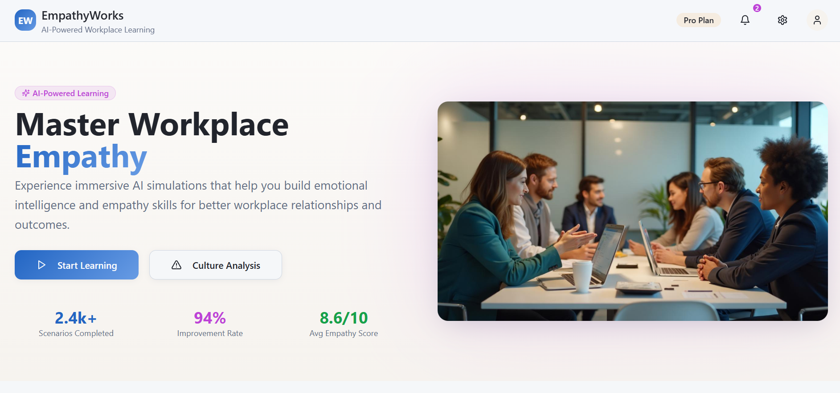

Slide 8
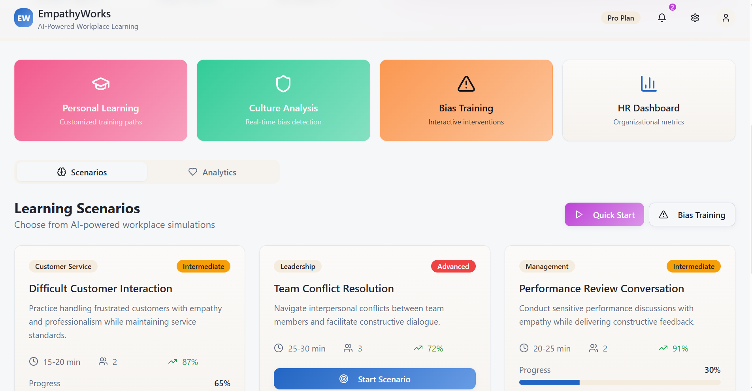

Slide 9
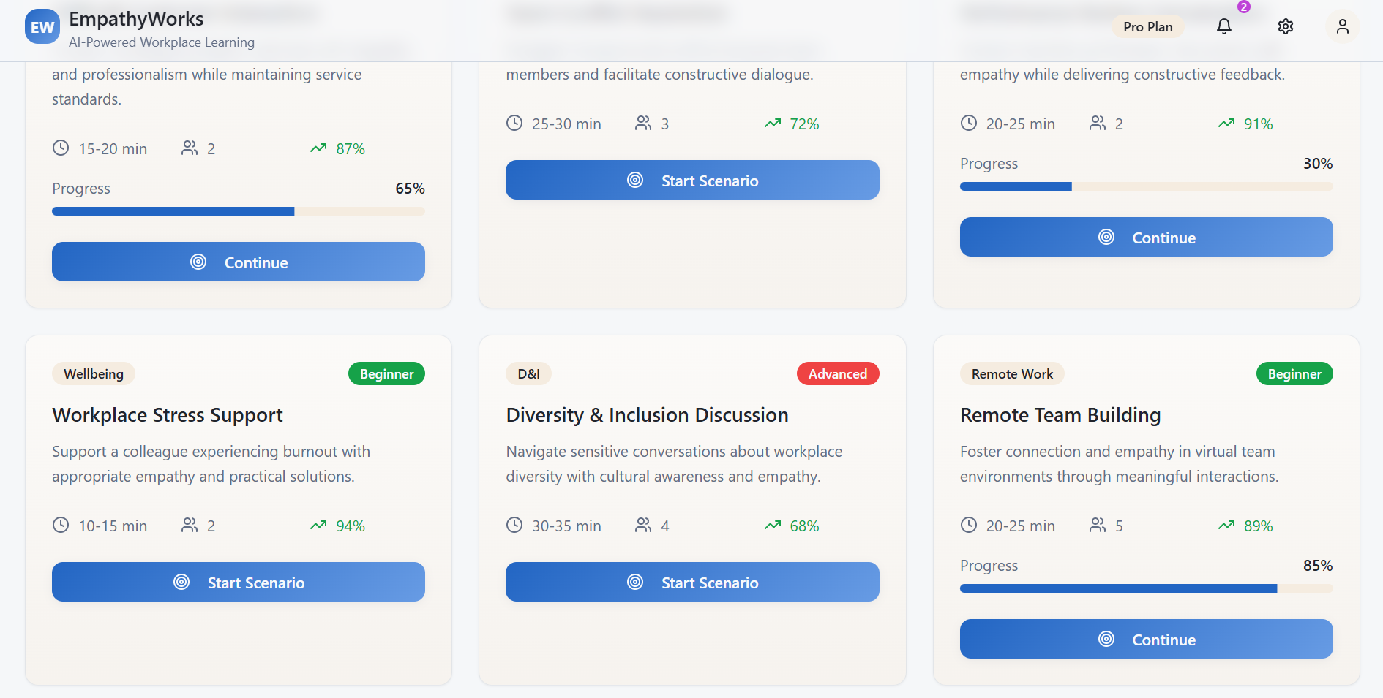

Slide 10
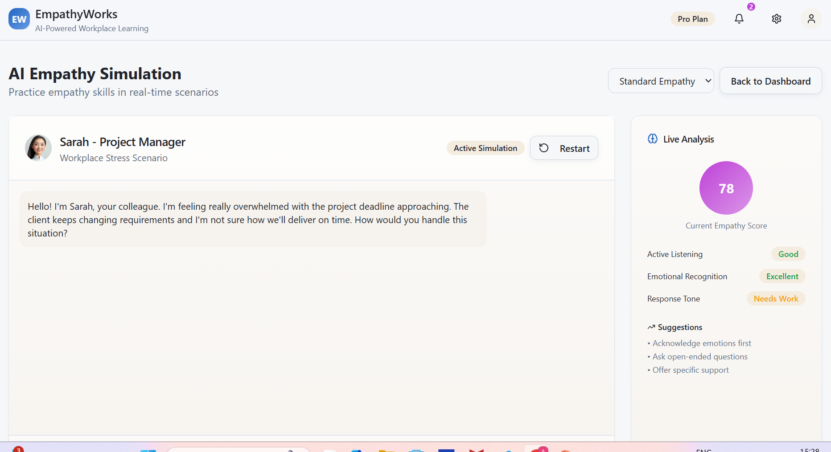

Slide 11
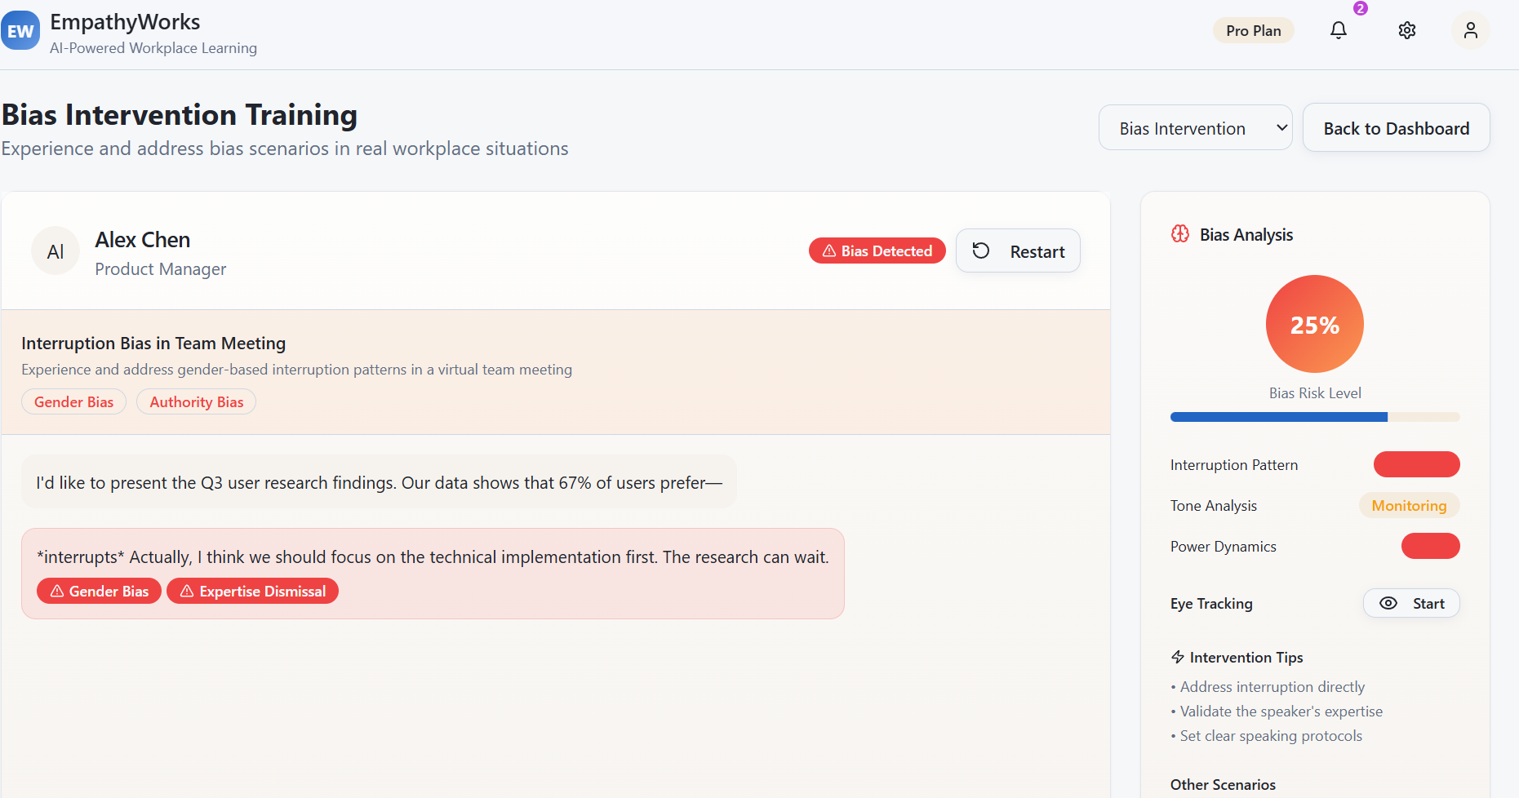

Slide 12
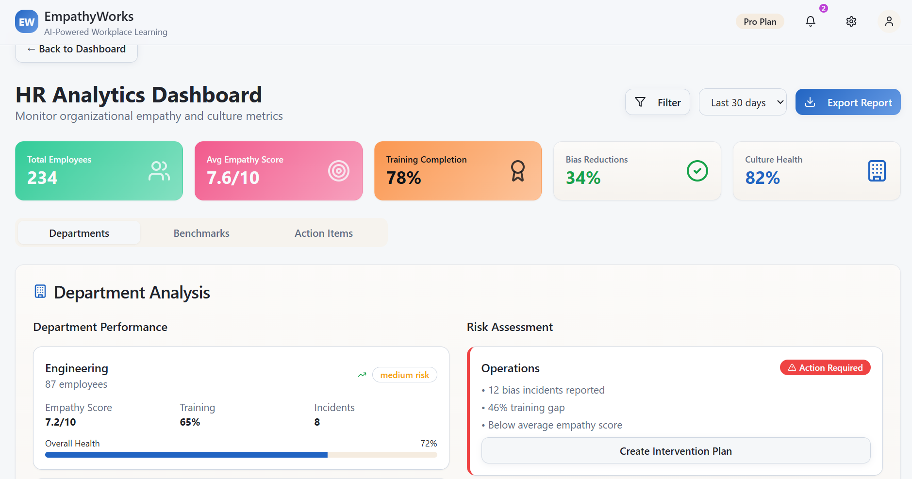

Slide 13
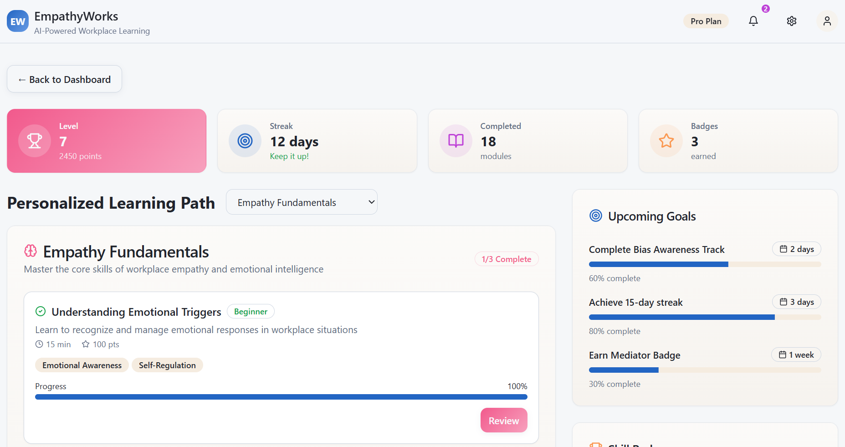

Slide 14
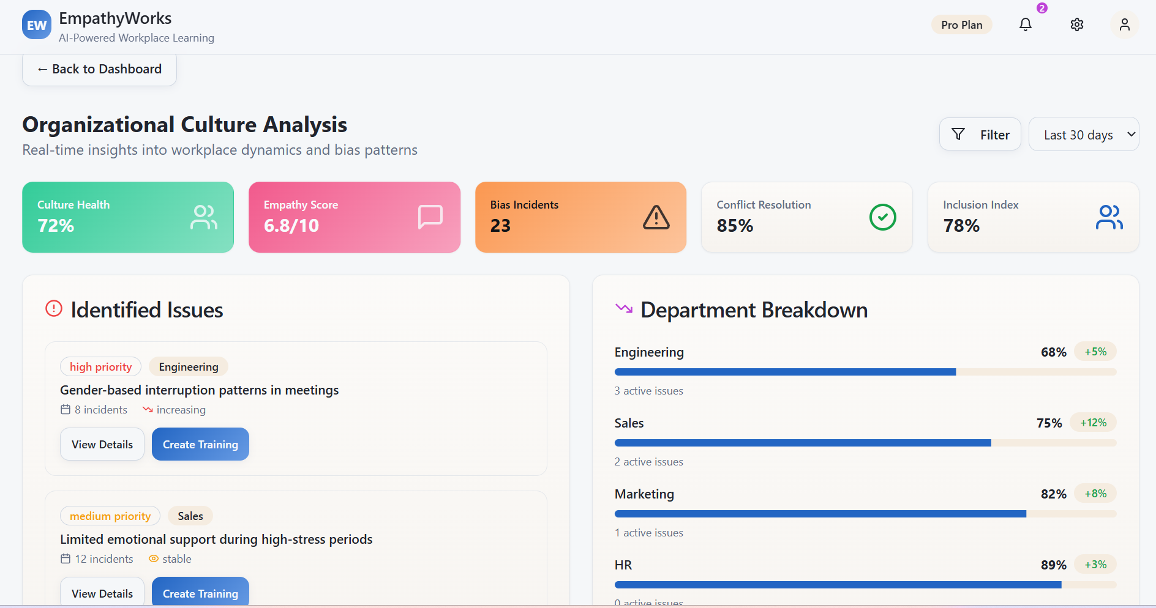

Slide 15

Journey Forward
Dive In: Explore the challenge, understand subtle bias, and uncover opportunities for impact.
Discover Insights: Analyze data, spot patterns, and identify key moments for immersive learning.
Design & Prototype: Bring scenarios to life with VR/AR, AI simulations, and reflection tools.
Test & Tweak: Pilot your ideas, gather feedback, and fine-tune for real-world impact.
Showcase Impact: Demonstrate how your solution builds empathy, changes behavior, and transforms workplace culture.

Slide 16
CHECK OUT OUR PROJECT
https://rockersteam.lovable.app/

